Slide 1
Metrics Workshop
21 June 2017
By Susan Storey
SDI Auditor, ITIL Expert, consultant and trainer

Slide 2
Metrics Workshop
Agenda
10.00 Welcome
10.15-11.00 – Introduction to Service Desk Metrics
  Overview – definitions explored and jargon explained
  The value of metrics to the service desk
  Why it’s important to get it right
11.00-11.45 - Key Metrics to Understand
11.45-12 noon COFFEE BREAK
12.00-12.45 – Best Practice for Key Performance Indicators
12.45-13.45 LUNCH and NETWORKING
13.45-14.30 Practical workshop
14.30-14.50 – Review of workshop results
14.50-15.00 – TEA BREAK
15.00-15.30 –Andy Parker, Ivanti – Do service metrics and quantum mechanics really have anything in common?
15.30-15.45 Action plan and questions
16.00- CLOSE

Slide 3
Overview
Definitions
Value to Service Desk
Importance of accuracy

Slide 4

We like you but we’re not sure why ….
Notes:
This is a collage, not a real photograph at all; notice the different sizes and perspectives, making it appear everyone is at the same party. This is an illusion.

Slide 5
Why we measure
To understand what’s good and what’s not
To provide management information for decision making
To influence behaviour
To improve resource management
To improve speed and productivity
Notes:
To understand what’s good and what’s not:
With repetitive, familiar and well documented incidents we can typically deliver rapid, consistent fixes and meet this goal, which is good. But - frequently recurring incidents are disruptive and reduce customer productivity. Measuring alone doesn’t change this; using insight to understand what’s happening shows us where to focus.
To provide management information for decision making:
Using facts and accurate data presented in a relevant and meaningful way supports business decisions.
To influence behaviour:
Balance each measurement with a corresponding quality measure eg, quantity of calls taken against number of calls closed; calls closed within SLA; calls closed at first contact and customer satisfaction scores relating to each.
To improve resource management:
Use historic patterns to predict future requirements and so you can plan for best use of resources.
To improve speed and productivity:
How fast you want something is not the same as how fast you need it. Find out the need for speed. Does the customer need all calls answered in 12 seconds, if you answered within 45 seconds increased productivity may result. Productivity improves with efficient and effective processes – measure process efficiency to identify potential improvements.

Slide 6
Terms and definitions
Metrics:
  measurements taken for specific reason; usually to develop insight
Measurements:
  detailed dimensions, extent and size of something
Reporting:
  presenting metrics with supporting information and narrative
Management Information:
  primarily for business planning and decision making
Business Intelligence:
  computer-based techniques used to analyse business data
Notes:
Metrics: measurements which are taken and reported on for a specific purpose or reason; usually to develop insight into the thing you are measuring
Measurements: detailed dimensions, extent and size of something
Reporting: presenting metrics with supporting information so the context is clearly understood
Management Information (MI): presenting metrics in a relevant and understandable way, for the primary purpose of business planning and directional activities
SDA: Service Desk Analyst, as defined by the Service Desk Institute.
Business Information or Business Intelligence (BI): Computer-based techniques used to analyse business data such as reporting, online analytical processing, analytics, data mining, business performance management, benchmarking, text mining, and predictive analytics.

Slide 7
Metric objectives
To support and manage a service, process or activity
To provide accurate, up-to-date and complete information
To validate management decisions
To highlight direction and targets for future activities
To identify complimentary/conflicting priorities
To ensure adaptability to changing market conditions

Slide 8

Help to connect the dots

Slide 9
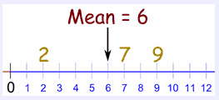
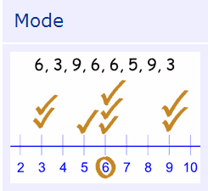
Maths definitions
Mean average - to calculate: add up all the numbers, then divide by how many numbers there are.
Mode – the number which appears most often in a set of numbers.

Slide 10
Value to service desk

Slide 11
Rules of measurement
Link to the bottom line
Link to corporate objectives
Be forward looking
Notes:
Follow the three rules of measurement to ensure you always have useful information available.
Link to the bottom line:
Make sure your measurements and metrics can be seen and are related to the financial business outcomes required by the organisation.
Link to corporate objectives:
Keep all your measurements focussed on what the business believes in, know your organisations vision and constantly relate your performance back to the delivery and support of that vision.
Be forward looking:
Actively seek business improvements, financial gain and efficiency gains in areas which are translated into business improvement.
Take control of the measuring process – deliver what’s requested but make sure you add value through additional commentary and suggesting solutions and alternative options.
Take the initiative by framing measurements relevantly
Explain what you do at every opportunity. You have to ensure the business is constantly reminded and aware of the value you offer through your Service Desk.

Slide 12
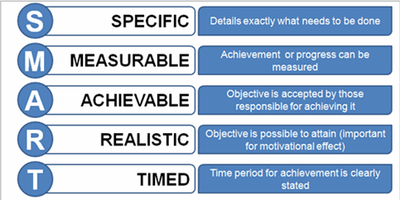
Goals, objectives, targets and trending
Goal – an aspiration
for where you want
to be
Objective – explains
how the goal will be
met (SMART)
Target – tactical, small attainments towards gradually achieving the goal
Trending – a line of best fit on a graph showing the general direction of progress or regress
Notes:
The goal is always aspirational. It should reflect organisational vision. Once a goal is achieved it needs to be maintained at that level, or a new goal must be set.
Objectives state how the goal will be met. They should be SMART (specific, measurable, attainable, relevant and timely).
Targets are smaller, shorter ambitions which are likely to be achieved when a specific plan or route is followed. A target is usually phrased as a percentage of a goal, ie, 80% of calls will be answered within 12 seconds. Targets achieved consistently show you are trending towards the goal.
The goal of answering every incoming call in 12 seconds is aspirational. Setting a target to answer a high proportion (say 80%) of calls within this focuses efforts on learning how to achieve the target consistently until the target is exceeded. Using the trend line is a visual indication of whether or not, eventually, you will reach the aspirational goal.
The target and the goal can be reset, with reasons for the goal firmly linked to the organisational needs. Sometimes targets are over-ambitious and cannot be met, reasons for this need to be understood; eg, a move to a new location; introduction of new technology; staffing patterns are altered.
Targets should be SMART: specific, measurable, achievable, realistic and timely. Goals can be a statement of anything you aspire to, eg, to reach world-class SDC standard in four years is a goal, with targets to achieve 2* status at first audit, rising to 4* over the next 2 years by following guidance from the audit report.

Slide 13
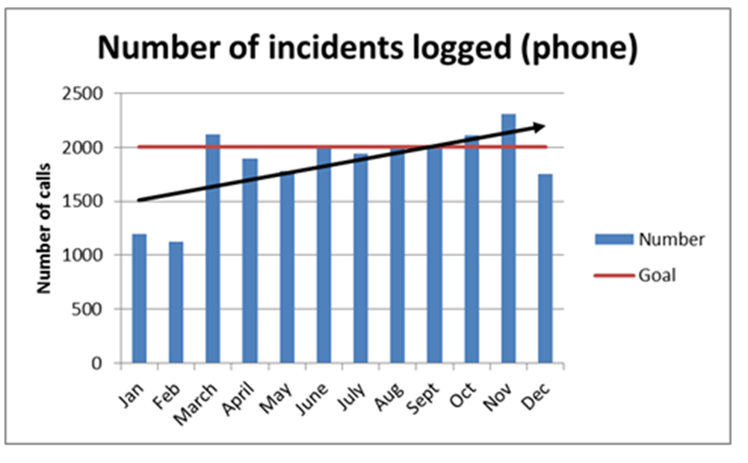
Using goals, targets and trend lines
Notes:
What information can we draw from this graph? What is your possible action as a result of analysing the information?
Answer: the trend is exceeding the target for number of incidents logged by phone. This trend is not reflecting the target to remain stable at 2000 calls pcm. Incidents logged are causing disruption to productivity and this is undesirable.
The trend line gives the cue to drill down and search for trends and repeated points of significance. There are four areas to explore.
Process:
Look for processes which are inefficient or not complied with. Where a process or service request is out of date or clumsy people may short-circuit it to speed things up.
Compliance:
Look for tasks carried out haphazardly or inconsistently, for example new joiners who are handled differently depending on who sets them up.
Quality:
Customer satisfaction surveys showing unusual levels of satisfaction with a specific type of service, Analyst or response time.
Compliments:
When customers report excellent service and are complimentary about your Service Desk staff this represents quality of service. Drill down to understand why – publicise it –reward and replicate it across other teams.

Slide 14
Common metrics to understand

Slide 15
What Service Desk Managers measure
ASA (Average Speed to Answer)
ABA (Average Abandon Before Answer)
ATT (Average Talk Time)
Availability to take incoming calls
Average call time
FCR (First Contact Resolution)
FLR (First Level Resolution)
User recalls (user calls to chase up)
Calls fixed within SLA
Calls breaching SLA

Slide 16
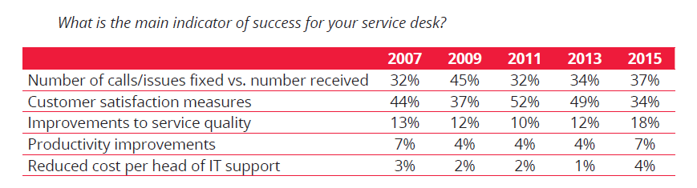
SDI benchmark survey 2015

Slide 17

Productivity measures

Slide 18
Count sheep whilst tending your flock
Analyst
Utilisation
(Avg No. of calls handled by SDA pcm) x (Avg call handle time in mins)
= xx%
(Avg No. of days worked pcm) x (No. of work hrs in day) x (60 mins/hr)
Analyst
Utilisation
(500 calls/pcm) x (10 mins/call)
= 52.9%
(21 working days pcm) x (7.5 work hrs per day) x (60 mins/hr)

Slide 19
What do SDAs do all day?
Log and deal with incidents
Log an deal with service requests
And……?

Slide 20
Possible reasons -low SDA utilisation
SDAs working day not wholly allocated to Service Desk
percentage of work is service requests
service requests are not logged
service requests are categorised as incidents
not all calls are logged
SDAs are resolvers on 2nd or even 3rd line support
SDAs time includes roll outs or project work
SDA is diverted into training new SDAs
Desk side support included (travel time not)

Slide 21
Reasons for reporting on metrics
To drill down into the dashboard.
To present KPI’s with additional commentary explaining performance highs and lows
To provide insight and understanding
To makes suggestions for improvements and recommend actions
To demonstrate the value of the Service Desk
To make decisions

Slide 22
Best practice for KPIs

Slide 23
Key performance indicators
Executive
Vision
Mission
Incremental steps
Goals
Objectives
Business drivers
Critical success factor
KPI’s
Metrics
Measurements
Data
KPI is a collection of metrics used to manage a process, service or activity
Either qualitative or quantitative
KPI categories:
  Compliance
  Quality
  Performance
  Value

Slide 24
Measurement affects behaviour
Percentage of calls open longer than one day (monitoring backlog) | Unhappy customers who have waited for resolution. SLAs breached have no ultimate time-frame
Percentage of calls closed | Rushed solutions, likely to be reopened and result in drop in customer satisfaction
SLA targets successful | Forced call closure, using stop the clock, logging user recalls incorrectly as new calls
Most logged per SDA per day | Chaotic logging pattern and unsustainable activity, poor attention to customer service mistakes
Notes:
Measure people – what can you expect? They will alter their behaviour depending on what you measure them on.
Remember, people have values around
To be safe
To be valued
To be in control
To have a sense of identity

Slide 25
Customer satisfaction – survey results

Slide 26

Don’t be trapped by data formatting!

Slide 27
Weighted scoring

Slide 28
SDC measurement requirements
Every metric needs a SMART target
All metrics should be trended towards goals over
  3, 6 and 12 months
All targets should be reviewed at least annually
Reporting activities must be undertaken
Business related metrics must be in evidence

Slide 29
Practical workshop
Insight over mathematics
Your task:
Groups A, B and C
Look at the statistics in front of you.
Depending on your group:
Record your initial observations
Assess level of quality, compliance, value or performance
Drill down
  Ask as many questions as you like for 3 minutes
Assumptions made
Group A –Service Desk Team
Group B –Service Desk Manager
Group C –non-IT management, Executives and Directors

Slide 30
One measurement, many stories
 | Jan | Feb | Mar | Apr
Calls In | 600 | 650 | 600 | 610
Calls closed | 550 | 500 | 570 | 580
Printer calls | 40 | 110 | 25 | 15
Remote | 30 | 150 | 40 | 45
FAQs | 5 | 70 | 20 | 30
Notes:
Bad reporting habits – churning out the same reports and letting the numbers speak for themselves.

Slide 31
Workshop review
Group A –Service Desk Team
Group B –Service Desk Manager
Group C –non-IT management, Executives and Directors

Slide 32
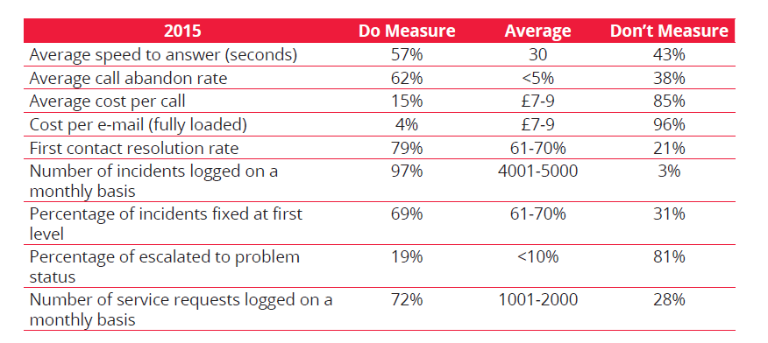
What we measured in 2015

Slide 33
SDI benchmark report 2015
10%
30s
£37,500
61-70%
65%
21-40 hours
<=10hours
4001-5000
£22,775
1988
52.9%
£7-£9
Notes:
300 – seconds on average talk time (5 minutes)
£4-5 average cost per call from SDI’s benchmark survey 2011
21-40 hours – induction training for new SDA’s
<10 hours – training existing staff
26-40 hours – time spent on training an SDA already in the job (3-5 days, 25% responding)
1988 year HUG (SDI) first appeared
52.9% average SDA utilisation
£22725 – SD supervisor average salary in 2011
65% intend to take ITIL ITIL understanding
£37,500 starting salary of an SDM
10% of SD’s who say they do nothing with info from customer satisfaction surveys
61-70% average first time fix rate
1001-2000 number of incidents logged monthly
46% require management theory, process, procedure and metrics to progress your career (includes leadership)

Slide 34
Measures required for SDC
Business related metrics
Reporting activities (accurate, consistent)
Target alignment
Number of incidents & number of service requests
ATA incidents and ATA service requests (all channels)
ABA
Average time to resolve incidents and fulfil service requests
FCR (Incident and Service Request)
FLR (Incident and service request)
Re-opened incident and service requests rate
Backlog Management
Hierarchic escalations (management)
Functional escalations (re-assignment)
Average resolution time by priority
Average resolution time by incident category and service request type
Comparison of overall service goals to actual
Self-help measured against target
Use and Quality of knowledge
Monitoring incidents caused by failed changes measured against goals
Total cost of service delivery
Average cost per incident and service request (cost per contact)
Average cost per incident and service request by channel
Employee satisfaction feedback
Staff turnover
Unplanned absence days
Periodic customer satisfaction measurement
Event-based customer satisfaction measurement
Complaints, suggestions and compliments

Slide 35

Making sense of data

Slide 36
Action plan and questions

Slide 37
Summary
Introduction to Service Desk Metrics
  Overview – definitions and jargon
  Value of metrics to the service desk
  Why it’s important to get it right
Key Metrics to Understand
Best Practice for Key Performance Indicators
Practical workshop
Review of workshop results
Andy Parker - Ivanti and Metrics
Action plan, questions

Slide 38
Thank you
Susan Storey
Susan.storey@bcs.org.uk
07831 576615
© Susan Storey Associates Limited

