Slide 1
Leicestershire County Council
Measure and Improve
In God we trust, all others must bring data. - W. Edwards Deming
If you can't measure it, you can't improve it. - Peter Drucker
Stuart Beale
stuart.beale@leics.gov.uk

Slide 2
Our Journey
One of only two County Councils to achieve 4 stars

Slide 3
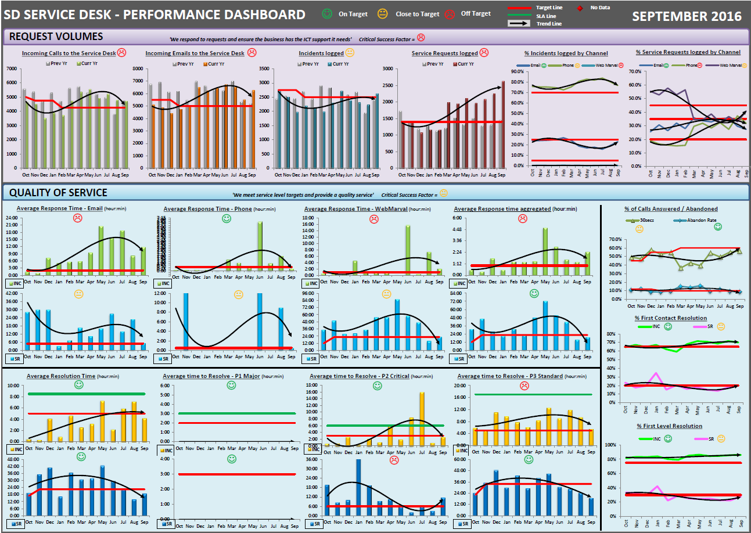

Slide 4
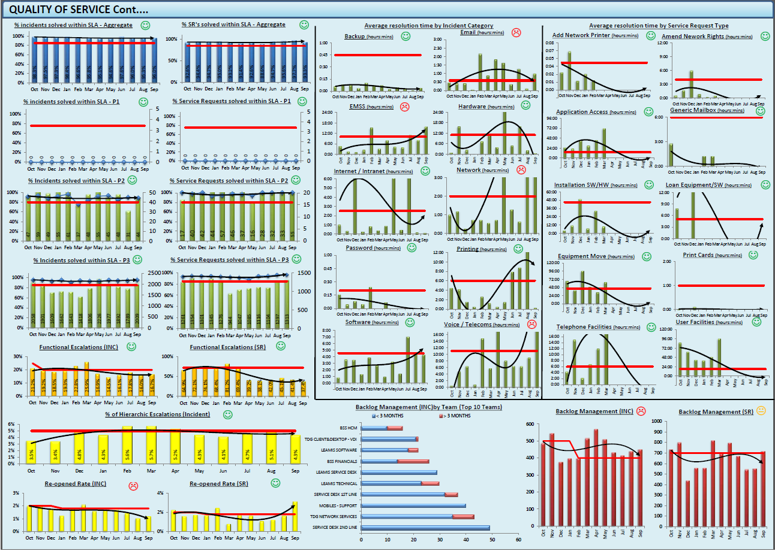

Slide 5
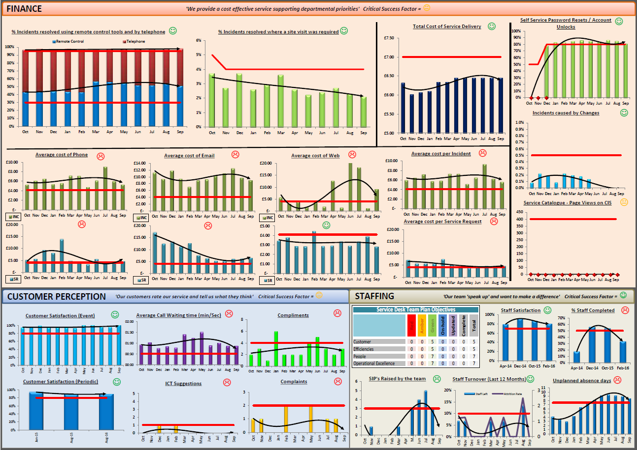

Slide 6
Result
Consistent request results
Improvement to quality service
Improvement to agent skills
Clear evidence of what is good and what is bad

Slide 7
What Next?
Reduce contacts to the Service Desk by 50%
12000 a month to 6000 a month
Reduce head count on the Service Desk by 20% full time equivalents
Get rid of two posts
Improve overall service quality

Slide 9
Results:
Contacts at 7000
SD headcount from 12 to 9 (plus apprentice)
Customer Satisfaction from 80% to 95%

Slide 10
Rethink Needed:
SDI considerations (never get 5 stars)
Austerity – SDI cost, reporting cost, etc
Why Measure
Keep my job
Identify improvements
What to Measure – A Balanced scorecard easily understood
Cost per Contact
Customer Satisfaction
Agent Utilisation
First Contact resolution
Abandon (Call) Rate

Slide 11
Rethink Needed:

Slide 12
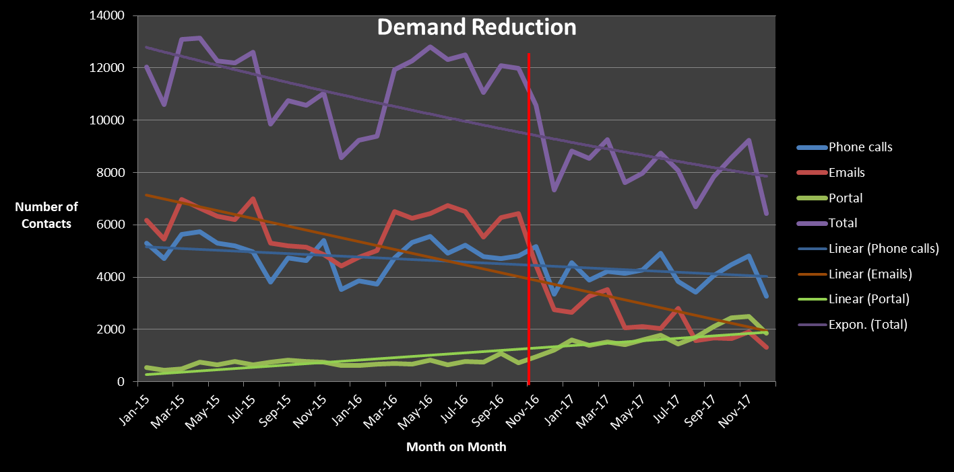

Slide 13
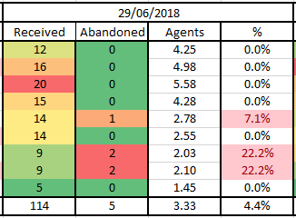
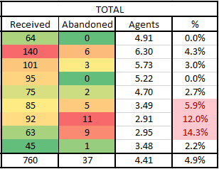
Phone calls to the Desk

Slide 14
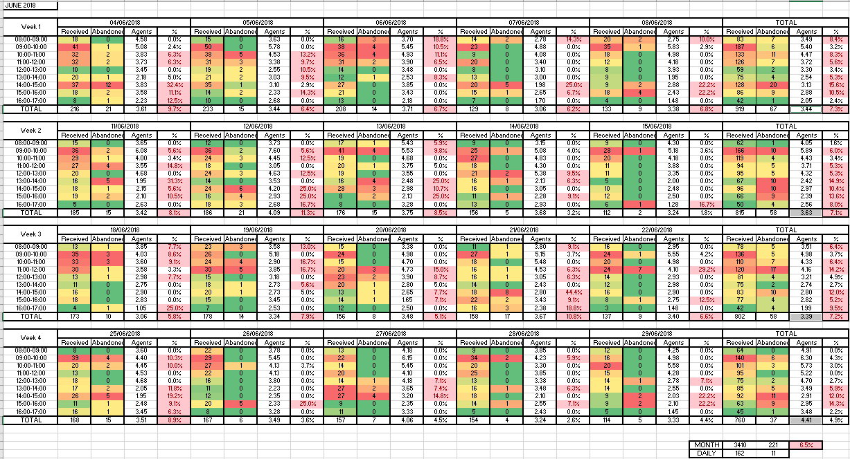

Slide 15
Twelve Months from Go Live
Nov 17 | Baseline Nov16
Abandon Rate = consistently below 9% | (Baseline = 27%)
Contacts = 6500 pm | (12000 per month)
Contacts (%) = reduction of 44%
Cost per Contact = £4.50 | (£6.50)
Customer Satisfaction = consistently 93% | (80%)
Portal Use = up to 22% | (one%)
Email reduction = down to 10% | (50%)

Slide 16
Cost per contact
Contacts
Spend

Slide 17
End Notes:
Leicestershire County Council
Stuart Beale – Customer Support Team Manager
Stuart.beale@leics.gov.uk
0116 3055622

