Slide 1






Who Am I
Martin Putwain
11 Years Managing Service Desks
Banking & Higher Education

Slide 2

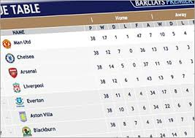

Understand what it means before you present it
Notes:
Building blocks

Slide 3

Report on the things they care about, not the things you care about

Slide 4
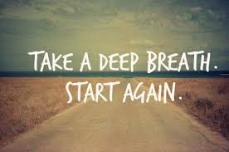
If you can’t get the reports you need be prepared start again and build it so you can get what you need.

Slide 5
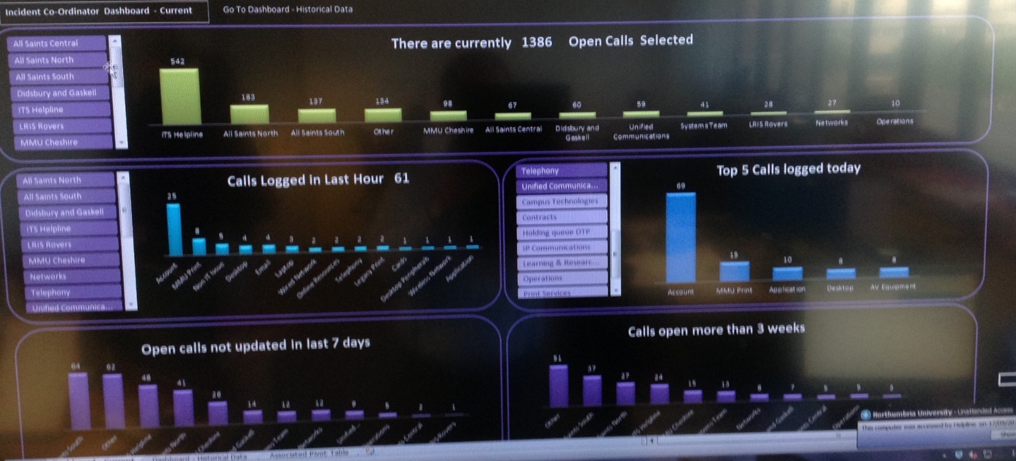
Report in an open and transparent way, build you team a dashboard

Slide 6

Collect data on as much as you can, report on what will support your objective

Slide 7

Report on enough, not too much, not too little

Slide 8

Your organisation is going to change and your reporting need to keep up in order to remain relevant

Slide 9

How are the recipients of your reports going to be viewing them?

Slide 10

Tailor your reports for their intended audience
Find me on twitter - @mrputwain

