Slide 1
The dynamic between people & tech in knowledge management Yasmin Dubash
11/06/2020

Slide 2
INTRODUCTION
Worked in Knowledge Management for 10 years in different industries – Law, Consultancy, Market Research and my current role is as UK Knowledge Manager at CBRE
Knowledge Management means different things to do different organisations – collaboration, lessons learned, knowledge sharing, knowledge retention, content repositories
I am on the NetIKX committee – run seminars quarterly (netix.org)

Slide 3
KM STRATEGY
What knowledge related business issues are you trying to solve? - this is not something a machine can do
Linking the Knowledge Strategy to companies IT strategy is key
As companies continue to grow and merge the volume of Knowledge within that company increases too
This can result in Knowledge silos with content stored in various places – from the apps, shared drives to peoples own computers
KM technology has been primarily focused on organising content and creating hierarchies and taxonomies to ensure efficient searching – this is starting to change

Slide 4
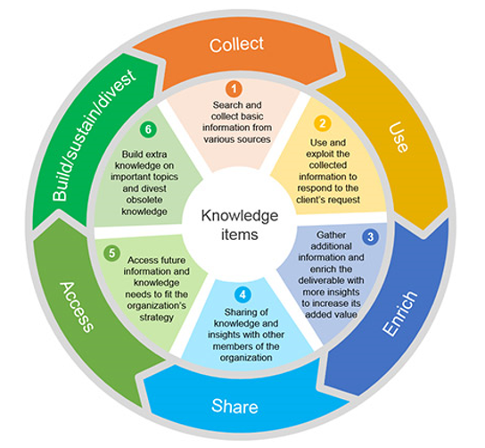
Technology as an enabler in KM
* Please ensure you have updated your footer information.
PC STEPS
From the ribbon select ‘View’ tab and click on ‘Slide Master’
In slide master view – ensure you select the very first page
Update footer text and change logo (if required)
Please ensure you remove either the ‘CBRE’ or the ‘Client Name’ text depending upon the logo placed in the document
MAC STEPS
On the View menu, point to Master, and then click Slide Master.
In slide master view, select the slide master in the navigation pane.
Select the text in the footer element, and update the copy.
When you complete the changes in slide master view, on the message bar click Close Master to return to normal view.
Please ensure you remove either the ‘CBRE’ or the ‘Client Name’ text depending upon the logo placed in the document
The two seem inextricably linked together – Tech features at almost every juncture of the KM cycle
Technology enhances KM and provides a vehicle for storing and manging knowledge. People act as facilitators
Wide array of technological tools available depending on your company’s needs – is it for collaboration, document storage, insights

Slide 5
TECHNOLOGY OPTIONS
Do people have the right tools at their disposal and understand how to use them?
Tool | What it’s best for
MS Yammer | Company wide collaboration – ask questions and discuss themes openly
MS Teams | Small discrete team collaboration, ability to work on live documents
MS SharePoint | Document storage, sharing, permissions
Slack | Collaboration tool – work with people offline as efficiently as if you were together – AI in search and chatbots
Salesforce | CRM, collaboration through the chat function. New AI functionality recently added
Trello | Project Management tool for teams – use of chatbots to perform tasks
Confluence | Organise knowledge efficiently, Wiki pages
Notes:
Each technical application needs to have a clear remit within the business to avoid confusion

Slide 6
AI IN KNOWLEDGE MANAGEMENT
Best for large unstructured data sets
AI-powered knowledge bases use new technologies - semantic search, natural language processing, and machine learning—to make it easier for employees to find the knowledge they’re looking for quickly and easily.
Enables users to find content they may not do otherwise
There is a distinct shift towards the ‘curation of content’
Project Cortex from Microsoft and Kendra from Amazon are two current examples of having the ability to contextualise data from various sources and surface it to end users
Notes:
Semantic search is essentially Meaningful search

Slide 7
CULTURE
To move between headings and bullet levels, use the ‘Indent List Level’ buttons found on the ‘Home’ tab
OR
NOT the bullet button
To move between headings and bullet levels, use the ‘Indent List Level’ buttons found on the ‘Home’ tab
OR
NOT the bullet button
All of this is not possible without addressing the culture within a business
Providing employees with the technological tools is not enough
You need to create a culture of collaboration, sharing and empowerment for employees
By fostering this culture organisational learning will improve which has far reaching benefits
It’s important to reward employees for sharing their knowledge, ideas and being innovative.

Slide 8
Thank you
Yasmin.Dubash@cbre.com

