Slide 1
Using ITSM to improve employee experiences: Lessons from IT Management Services Leaders, Waterstons
Tuesday | March 21, 2023
Notes:
For Simon to present:
Join us as we speak to Head of Automation and Infrastructure Monitoring Lead at Waterstons, who'll share an insight into how they service their clients and help them deliver support using Freshservice. We’ll also share unique insights into delivering exceptional user experiences, whilst ensuring agents are proactive, instead of reactive.

Slide 2
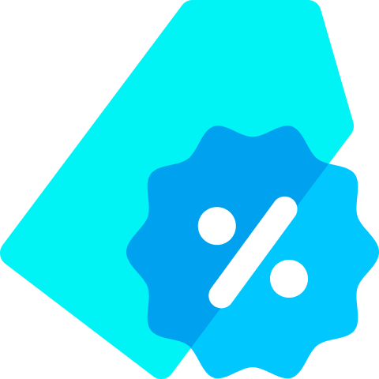
Freshworks at a glance
2010
FRSH
$495M & +37%
Founded
IPO Sept 2021
FY22 Annual Guidance &
YoY FY22 Q3 Revenue Growth
5,000
60,000+
Recognition
Employees
Total Customers
Leader in 3 Major Peer Reviews Recognized in 3 Gartner Magic Quadrants
Notes:
For Simon to present:
These talking points align to each metric, starting at the top and going left to right.
We started in 2010 and in the SaaS space, by this time, we had a later mover advantage. We went at it with a fresh approach.
In 2021 we went public on the Nasdaq, demonstrating the strength of this approach and our momentum. OPTIONAL: Prior to going public, we were in the Top 10 in Forbes Cloud 100 and Capital G, the investor arm of Google, was our main investor.
We’ve reached nearly $500M in yearly revenue and currently have 37% year over year growth - we’re at a size that we can serve customers regardless of scale, where ever they are are across the globe.
We have 5,000 employees and over half are engineers/developers, one of the highest ratio in this space (NEED TO VALIDATE)
This has lead to an amazing pace of innovation, as evidenced by Freshworks having 3 different products in Gartner MQs
We have 60,000 customers. This shows our roots - we started with the SMB market. Our vision was building software that was ubiquitous. For companies of all sizes from all over the world to access to the power and promise of SaaS and the cloud. To do this we built a simple yet powerful integrated all-in-one solution that unifies domains not typically seen together - IT, Service, Support, Sales, Marketing - such that mid-market and enterprise companies couldn’t help but see the value and now makes up over 50% of our on-going business. .

Slide 3
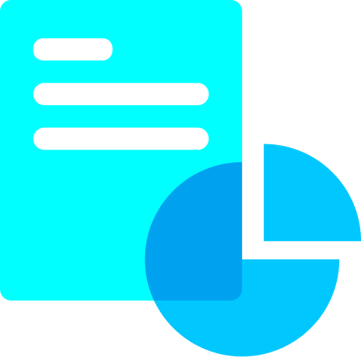
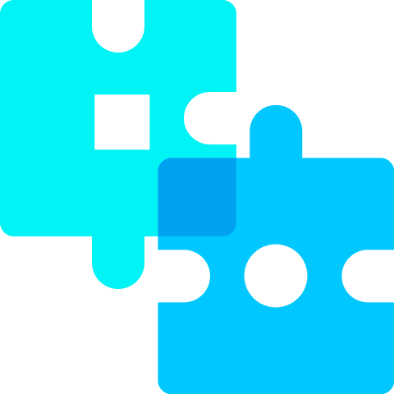
Today’s expectations
Fast AND Easy
Affordable AND Powerful
Modern AND Enterprise-Grade
VALUE
Low TCO
Intuitive
Unified
Fast & Easy
Anywhere, Anytime
Automated
Conversational
Collaborative
Notes:
For Simon to present:
Today, many businesses struggle to deliver truly exceptional customer experiences.
Companies typically have fragmented systems that have become very complex over time. They’ve taken an add-and integrate approach as the business has evolved.
For example, to meet customers on new digital channels like Instagram or WhatsApp, many companies decided to add solutions for these specific channels.
The consequences are poor experiences for customers that lead to low productivity for employees and high costs for the business.

Slide 4
Freshworks and Waterstons
Simon Johnson
General Manager and Regional VP
Freshworks UK&I
Adam Lisik
Head of Software Ops and Automation
Waterstons
Daniel Wrend
Infrastructure Monitoring and Maintenance Strategic Lead
Waterstons

Slide 5
An introduction to Waterstons and Freshservice

Slide 6
Improving agent experience with Freshservice
A decrease in average time to resolution by over 35%
Employee satisfaction with Freshservice is above 95%
Notes:
Here’s what they’ve done:
Automate ticket flows, reducing manual resolution of first line tickets – improving customer experience, first fix and overall SLAs.
Grow and streamline services especially over the pandemic – the ease of Freshservice allowed other areas of the business to work with our Service Desk team to continue to deliver services when we saw unprecedented demand.
Since 2019, Freshservice has enabled Waterstons to decrease average time to resolution by over 35%
Satisfaction of Freshservice across the business (not just Agents), is over 95%.

Slide 7
How Waterstons increased agent productivity
How Waterstons saved 26 days’ worth of effort in one month by delivering zero touch automation
Notes:
How do Waterstons enable automation within the Service Desk to create better quality, faster resolutions for its customers?
When it comes to monitoring infrastructure, how do you identify alerts and changes to infrastructure and ensure you respond to the most appropriate tickets, reducing less important tickets / cases that don’t need an agent to intervene and manage?
For Waterstons Service Desk:
Every single ticket that comes to Waterstons has some element of automation enabled. From initial triage to full end-to-end delivery of service requests.
In February alone, Waterstons saved 26 days’ worth of effort by delivering zero touch automations on service requests.
For Waterstons Infrastructure Monitoring (NOC) teams:
Workflow/automated resolution - Deflected just over 22% tickets through automated resolutions since introducing Freshservice.
Alert management – Since introducing AM to our NOC services, it helped Waterstons reduce alert noise and subsequent tickets for some teams by up to 71%.

Slide 8
Reduced incidents generated via alerts by 28%
Notes:
How are you using bots in Freshservice? What is the use case?
For End-users and Agents – Watersons have the Freshservice Freddy Chatbot integrated with Teams on several of their instances. Allowing end-users and agents to interact with their ticket, managing their requests, and find information without leaving Teams. Even on the move.
Freddy Machine learning for Alert management – Reduced incidents generated via Alerts by up to 28% on some of Waterstons’ instances since enabling the feature.
Freddy suggestions for ticketing – speeds up first line tasks by triaging tickets by recommending categories, suggests canned responses, and solutions when agents are dealing with tickets. Helping Waterstons’ teams become more efficient and speed up resolution times.
How are you using self-service with Freshservice?
All instances we manage have a self-service portal – Drive engagement via the portal over traditional means e.g. Phone and Email.
Bolt on automation via workflows for service requests, integrated with other systems and platforms to enable “zero-touch” requests for IT.
However, it needs time and effort put into in order to get the most out of it. End-users won’t see the value in it if there is little content for them to interact with.

Slide 9
How Waterstons and Freshservice rapidly decreased response times
Enabling consistent customer service and resolving queries, faster.
Notes:
What are the results today?
First response time is around 43mins on average – over 69% decrease since introducing Freshservice.
Resolution time is around 3hrs 8ms on average – over a 64% decrease since introducing Freshservice.
How do Waterstons manage VIP customers?
VIP requests are flagged within Freshservice using the built in VIP feature. Waterstons use automations to notify Teams, watchers and delivery teams.
The focus is to deliver the VIP experience to all users, and Waterstons are aiming to do this by automating requests and the processes end-to-end as much as possible. This delivers a better experience for all users not just a subset of key stakeholders.

Slide 10
Managing hybrid working and remote working.
Enabled remote access and the ability to login and update incidents anywhere
Notes:
How are you able to manage hybrid working and remote working with Freshservice?
Freshservice enables Waterstons to have a hybrid approach to working – they have team members all over the UK with no enforcement of returning to the office. Collaboration is key – using teams integrations and built in features, Waterstons Agents are able to work just as closely remotely as if they were sat next to each other in the office.

Slide 11
Thank you!

