Slide 1
Revolution
The Future of Service Management in 2023
Patrick Bolger | Chief Evangelist | @patb0512
© Hornbill 2023 | The Future of Service Management in 2023
Notes:
Introduction…
2023 - a revolution in service management.
Why? Bigger picture…amount of change…clear that IT can no longer follow the traditional path.
The tier one analyst groups calling this out.

Slide 2
For the industrial revolution in services, we believe that a crucial tipping point has just passed. After decades of incremental change, service delivery is now set on an irreversible path to radical reinvention.
McKinsey & Co
© Hornbill 2023 | The Future of Service Management in 2023
Notes:
McKinsey.
Crucial tipping point already passed.
Incremental change isn’t fast enough…
Service delivery - on an irreversible path to reinvention.

Slide 3
Any executive who has risen to the top of an organization already has compelling reasons to focus on service operations. Service operations account for at least 80 percent of operating expenses at major banks, healthcare providers, and telecommunications companies. In retail, that figure can reach 98 percent.
McKinsey & Co
© Hornbill 2023 | The Future of Service Management in 2023
Notes:
Another important point.
Service operations is expensive.
80% of operating expenses in most industries, up to 98% in retail.
Business rightly focused on reducing this cost, especially now.

Slide 4
Economic Headwinds demand efficiency like never before
© Hornbill 2023 | The Future of Service Management in 2023
Notes:
In tough times, businesses naturally turn their attention to cost and efficiency.
Major economies bouncing back from covid…global economic crisis. 2nd round of austerity …massive cuts to UK public services, not yet recovered from the last decade of austerity…banking crisis
Conditions place a burden on IT to deliver cost and efficiency measures like never before.
However, businesses still demand value, and if IT cannot deliver both…writing on the wall…in bright colours.

Slide 5
42% executives believe IT can be outsourced with minimal impact on the business
Hornbill Confidential © 2022
© Hornbill 2023 | The Future of Service Management in 2023
Notes:
Outsourcing is on the rise…(slide later)
Worrying thing is that four out of 10 business execs believe…
Need to deliver highly visible business value...
However, to achieve this, we first need to recognise a critical fact…

Slide 6
We have changed
© Hornbill 2023 | The Future of Service Management in 2023
Notes:
We have changed.
Lived through a decades worth of change (maybe more)…Value chains, belief systems, baselines.
World went digital first.
Employees ….needing more assistance…working remotely…hybrid…reliance on technology increased exponentially.
Experience is the new battlefield. Employees in the driving seat, demanding more, tolerating less.

Slide 7
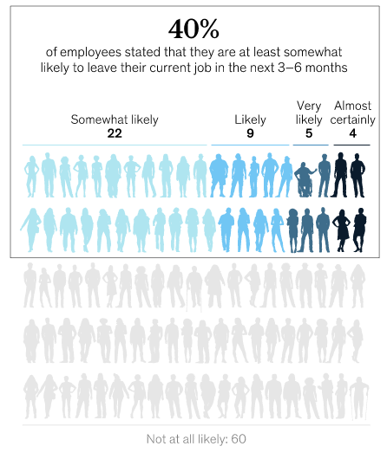
The Great Resignation is Real
© Hornbill 2023 | The Future of Service Management in 2023
Notes:
The Great Resignation is real.
McKinsey survey data… 40% of employees somewhat likely to leave within 3-6 months.
Half of your team…. Think about that…which members of your team
Most talented employees…in demand.

Slide 8
Likelihood that employees will leave their current job in next 3-6 months
The Great Resignation is Real
© Hornbill 2023 | The Future of Service Management in 2023
Notes:
Global phenomenon…every sector.
Local factors… UK …NHS staffing crisis.
Quarterly figures… Sept 22, over 133,000 vacancies…10% of entire workforce.
Tech sector…Jan - May 22, 870,000 jobs open, demand for software developers +59% (2019).
Downturn…economic uncertainty…tech sector is recruiting; developers still 50% of all open roles.

Slide 9
War for Talent
© Hornbill 2023 | The Future of Service Management in 2023
Notes:
U.K. business advisors Willis Towers Watson… 2022, 4 million resigned each month…seek new jobs…change careers entirely.
Remote working… emotional cost of leaving is lower…location no longer a concern, employees…in the driving seat when looking for new positions.
There’s a huge war for talent
Employers on the back foot. Once in a lifetime event…no playbook.
Business must rethink the concept of the office, work, and jobs.
Creating a sense of purpose and belonging…attract the right skills…deliver an experience that retains them.

Slide 10
Employees demand experience
© Hornbill 2023 | The Future of Service Management in 2023
© Hornbill 2022 | The Future of Service Management in 2023
Notes:
Old world, Employee Experience depended on three environments:
Cultural - Feelings we get working for an organization
Physical – the spaces we work in
Technological – the tools we use to do our work
Remote working … impacted corporate culture. Physical space…. ceased to exist…being redesigned for collaborative purposes.
Technology…greater role in the Employee Experience…being refreshed at an unprecedented rate….we need to rethink its purpose….focus shift….infrastructure to people…services to outcomes.
From a professional perspective…incredibly exciting time for technology…IT teams solving business problems. Poor performers…

Slide 11
Experience must be…
Designed
End-to-End
Digital First
Easily Adapted
Efficient
Journey
ESM
Workflow
Codeless
Automate
© Hornbill 2023 | The Future of Service Management in 2023
© Hornbill 2022 | The Future of Service Management in 2023
Notes:
Start learning from past mistakes….three years of remote working…self-service adoption rates … shockingly low.
Is your adoption rate above 50%?
Why… portal was designed for IT, not for the people who use it. Sticking a chatbot…employees may not want… poorly designed service experience will not help.
If you don’t design customer journeys and service experiences…strangle adoption, people won’t use it.
Your employee experience must be…
Understand the employee journey, across every service delivery team (ESM). Great workflow engine…codeless…non-technical people can adapt it. Once you understand the employee journey….automate delivery…make it more efficient.
Tall order….great example customer MSE

Slide 12
Steve Whittle
Head of Digital Operations
ESM Showcase
No. Agents: 339
End Users: 18,000+
ESM Usage: IT, HR
Digital Services new joiner process
One process, all touchpoints
Experience mapped for all personas
Automated system access for frontline staff
Automated locum doctor account creation, system access, and disablement
Highly visible business value
© Hornbill 2023 | The Future of Service Management in 2023
Notes:
Steve Whittle…Mid & South Essex NHS Foundation trust.
Streets ahead …understanding their business…challenges…using technology to address them.
Old joiner process…managers could use self-service to log a new joiner's service request. Complexity of the new employees needs…linked service requests raised…sent to different teams … system access. Worked, but the experience was not focused on their employees…this year...
Months…different teams…who is requesting what, how are they requesting it, and what teams must do to deliver it.
Single Digital Services new joiner process.
One process….all the on-boarding touchpoints.
Experience matched to different personas…Doctor/Nurse…automatically selects systems.
Because ….legacy system decommissioned…Onboard 200 Frontline Care workers…looking after patients in the community….access to patient records, blood results, and other medical information.
Like every NHS Trust…experiencing high levels of sickness and absence. Agency staff….deploying a Locum doctors service on Hornbill self-service portal…admin staff on 24-hour shifts in A&E. Input the locum doctor’s details…activity for governance team to approve…passed to the service desk…hit one button…automatic account creation…system access….safely distributed…end of shift…automatically disabled… returned to a pool…
MSE executives no doubt IT value….Digital transformation in practice…using technology effectively…solving frontline issues…better healthcare to 1.3 million people.

Slide 13
Notes:
ESM goes mainstream…flawed thinking… ESM = ITSM outside of IT.
Immediately assumes IT perspective….approaching this from the employee’s perspective…touchpoints across the business.
Enabling businesses attract the right skills….employee experience that retains them.
Scale… enable non-technical people to use technology to solve problems within their own teams.

Slide 14
Waltham Forest Council
ESM Showcase
No. Agents: 700
End Users: 25000
ESM Usage: ICT, Business Operations, HR
This has revolutionized the recruitment process.
This has made life so much easier for everyone in Business Support.
All I can say is, this is brilliant!
HR Smart Guide Download
https://info.hornbill.com/hr-smart-guide
The online forms are so user friendly and straightforward.
Such a massive improvement on the previous (incredibly challenging) procedures.
Notes:
Waltham Forest…great example…HR team can achieve with codeless.
IT…. a couple of processes…HR team…within 6 months
ESM….biggest opportunity for IT, since IT….approach is critical.

Slide 15
Vinci Construction UK
Gentle introductions, small steps.
Don’t go with your IT hat on.
Don’t go with a proposal.
Darren Rose
Central Services Operations Director https://www.linkedin.com/in/darren-rose-850464a/
Teams are doing the same things.
Their challenges are similar.
Solve one thing, and keep building.
Momentum creates more demand.
Don’t call it ESM (too IT-centric), can be off-putting.
Discussing business challenges breaks down silos.
Notes:
Podcast…Darren Rose…FSP
ESM introduced 3 years ago…now 60% of their business units…diverse requirements…On-site Facilities teams … order a drone survey through Self-Service.
Darren shared great insights…how to make ESM go viral…
…Get going, get running, prove the case…look what we’ve done
…Other teams will think…we don’t work like that.
… Just ask what their problems are.
…supporting employees, improving experiences, keeping staff productive.
Challenges…unable to prioritise, firefighting, no baseline for improvement.
Solve one thing, then keep building…
Once you get this going, teams will come to you asking for help
…Just talk about how teams support their employees, and how you can help.
…One of the biggest benefits of ESM….working with other teams… finding bottlenecks and waste…eliminated by automating across service functions.

Slide 16
Market Polarisation
Focus on Enterprise (ESM)
Focus on transactional IT
“Outsourcing market continues to grow as war for talent intensifies. For the first time in the UK, cost is no longer the #1 driver. The need to focus on core business is the primary driver, followed by access to resources and talent.”
“ ESM is a game-changer. Hornbill has now been rolled out to 60% of our business units. Teams control their own destiny and can transform service delivery without technical gurus. Automation is now front and centre in the employee experience, and the value that we are delivering is highly visible.”
Source - https://www2.paconsulting.com/UK-IT-outsourcing-study-2022.html
© Hornbill 2023 | The Future of Service Management in 2023
Notes:
Real polarisation of the market.
A few years of exponential change…cannot continue with the old ways, focussed on transactional IT. Poor performers… fail to show cost and efficiency, and tangible business value…absorbed by shared services…outsourced.
PA Consulting on UK IT outsourcing …happening at pace
Digital champions…working wonders…tackling challenges…improving business outcomes…,getting noticed…the true value of IT. Focus shifted…infrastructure to people…services to outcomes. The future of service management in 2023, and beyond.

Slide 17
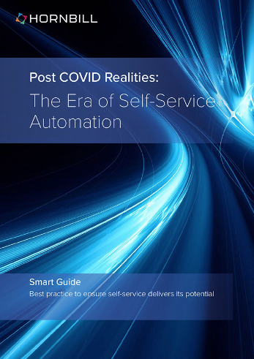
An undeniable shift
Low-Code global market ($12.5B in 2020) will explode to reach $190.8B by 2030.
The economic consequences of Covid-19 have validated the low-code value proposition. Hyper-automation drives business units to execute their own ideas and deliver more automation across their applications and workflows.
Era of Self-Service Automation
https://info.hornbill.com/a-new-era-for-self-service-automation
Experience is the new battlefield
https://bit.ly/3DRMhWE
Notes:
Now, IT busy modernizing systems…migrating everything to the Cloud…an undeniable shift happening
Low code market exploding.
Powerful technology … into the hands of people…don’t need highly specialised skills.
Democratising technologies…low-code platforms, process orchestration, and automation…technology more accessible. No skills gap…people who are closest to the problems…tackling challenges, control of their destinies without involving IT.
That doesn’t remove IT from the equation. Injecting cutting-edge technology….helping teams get the most from it.
Must master the employee experience….target automation at improving it, making it easier to use.
If we can do this, IT will be trusted to lead the way.

Slide 18
Revolution
The Future of Service Management in 2023
Patrick Bolger | Chief Evangelist | @patb0512
© Hornbill 2023 | The Future of Service Management in 2023

