Slide 1
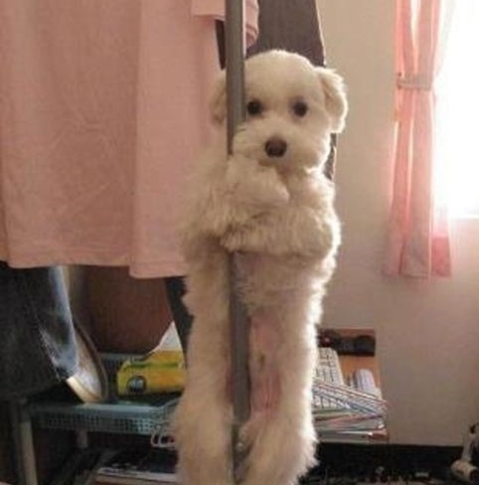
Structurally Flexible IT
From pole to dancer

Slide 2
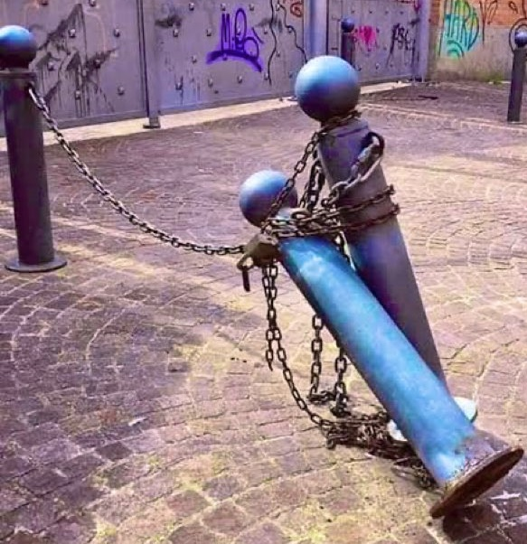
Intro
Once upon a time the IT Service Desk in WD was as rigid as a metal pole, now we're as flexible as a dancer
Over the last few years the team have been transforming to be a ‘service desk that goes beyond customer expectations’.
This is how we became more flexible than ever by building trust, having the correct structures, embracing diversity, and putting the customer first.
Notes:
SS - For those of you who came here expecting to see pictures of pole dancing…

Slide 3
About Willmott Dixon
Notes:
MG - Established 1852 – Family owned construction company: That’s Rick Willmott there on the screen - £1billion turnover, but this is construction and the margins are slim! – Strong social values: Carbon neutral since 2012, Net zero by 2030, targeting gender pay parity by 2030. In 2022, Willmott Dixon topped the prestigious Sunday Times Top 100 Best Companies to Work for.

Slide 4
“No one ‘builds a house.’
They lay one brick again and again and again and the end result is a house.
A remarkable, glorious achievement is just what a long series of unremarkable, unglorious tasks looks like from far away.”
Tim Urban
Building a house
Notes:
MG – We’re going to talk about our transformation which is really summed up well by this quote. It’s relevant because it relates to the construction industry and the improvements to our IT department but it’s really about procrastination. Anyone can have a dream or a vision. It takes effort and determination to continually perform the mundane steps to turn that design into beautiful reality

Slide 5
Pain points

Slide 6
The original version of the service desk was not a great success
Ticket backlog soon got out of hand, but this wasn’t visible to anyone:
During one SMT meeting, the new CIO asked how many open tickets there were
Reluctantly, they conceded that there were around 1,600 open tickets (for approx. 2,000 customers)
and over 1,000 hadn’t yet been assigned to anyone to look at
Ticket volumes soon dropped. Only when customers realised there was no point logging anything
In the beginning…
Notes:
SS

Slide 7
At the time, the rest of the department was not much better
There were no processes, no CAB, no monitoring, no governance
Without testing it, an engineer deployed a global change to group policy that had the effect of taking every PC off the corporate network
By the time the problem was noticed, hundreds of customers were no longer able to work
Each required an engineer to visit to manual reconnect them to the network
Thousands of business hours were lost on WD’s very own ‘Black Friday’
In the beginning…
Notes:
SS

Slide 8
Sam’s arrival
Notes:
SS

Slide 9
Sam’s
arrival
Sam’s arrival
Notes:
SS
No energy
Emailing to ask for help
No reporting
No ownership
Nothing documented – tea rota
No wall boards
Blind
The team was wrong

Slide 10
Ch ch ch changes…
Notes:
SS
Put in service now, for the first time ever we had the visibility of tickets
Didn’t completely go to plan
Put structures in place:
Weekly ops meeting
Reporting template
KPIs but no SLA’s
Behaviours and hired on personality over technical skills
Said yes, instead of no.
Humbly accepted criticism
Build the teams confidence – give them the power to try things even if I knew it wasn’t going to work
The key was making small intricate changes over a period of time. Had to put the service desk in to the centre of the dept not on an island on its own.

Slide 11
The hybrid service desk
Notes:
MG How we run a successful hybrid service desk:
Based across the country (Letchworth, where the head office is, but with member of the team also in London, Durham, Liverpool, Sam in Stafford. Even some people in Stevenage)
Tools: ServiceNow, Cirrus
Regular team meetings and stand ups, but with an emphasis on the social element of the team, everyone sharing their experiences both in and out of work, their strengths and concerns, creating a culture where they can help and support each other
Continual interaction – Teams chats for the team but also for other stakeholder groups (licensing, procurement, etc)
Cirrus is configured to support this: the team are delivered new customer calls even if they are already in a Teams call. If they’re already speaking to a customer, that takes priority. But if they’re speaking to a colleague, coaching and mentoring, or just having a chat about the weather, this can drop quickly to take the incoming call

Slide 12
Matt’s arrival
Notes:
MG

Slide 13
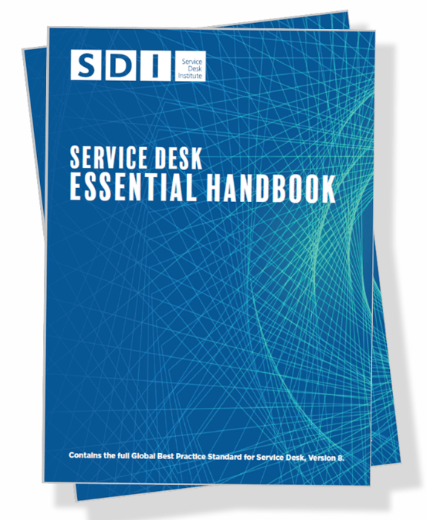
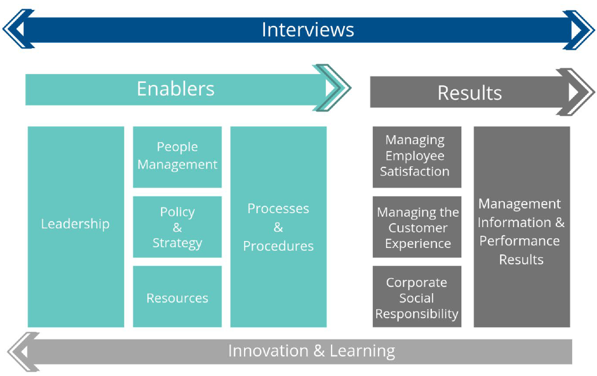
Service desk audit
Notes:
MG

Slide 14
Define the operational model
Embrace and prepare for staff turnover
Deal with pain points
Write stuff down
Measure improvements
Building blocks for the desk
Adopt a ‘ServiceNow first’ approach
Have fun ☺
Notes:
MG

Slide 15
Customer feedback

Slide 16
“The support from the IT Team has been great. It has been a marked change over the past 5-6 years. Great to see service desk operational from 7am since some of us start on site at that time”
Senior Building Manager
“Service has improved massively and has stayed good over time - it is difficult see how it can improve much more”
Head of People
“The service has improved greatly - Thank you”
Quality Delivery Manager
“Service desk has been great, courteous and obliging with speedy responses”
Senior Project Surveyor
“The service from emailing IT helpdesk through to resolution is excellent. I don’t know another business who deals with service calls so promptly- thank you!!!”
Principal Surveyor
Customer survey 2023
“IT department is doing a cracking job, problems get solved quickly and IT chat responds in a couple of minutes. Can't fault the process”
Senior Estimator
“Service desk is great, deal with problems there and then”
Senior Project Surveyor

Slide 17
“IT has come a long way in the last 4 years and it is a difficult job. 4 years ago you weren't sure what service you would receive”
Head of Planning
“IT has moved on so far in the last three or four years. I never used to want to call for help but now ringing the service desk is a joy. Well done and thank you”
Preconstruction Manager
“Service desk are super quick and super helpful, always fix problems on the first call”
Assistant Building Manager
“I think the IT Dept is absolutely excellent”
Customer Service Manager
“IT Service desk do really well, can always get help very quickly ”
Assistant Systems Manager
Customer survey 2023
“The service desk has improved massively - they are really responsive and deal very quickly with my issues”
Principal People Manager
“I believe that the day to day IT operations are exemplar. Well done!”
Deputy Chief Operating Officer

Slide 18
 | 2018/9 | 2022/3
Overall Improvement | 96.5% | 98.8%
Incidents & Responsiveness | 96.6% | 98.1%
Requests & Procurement | 89.3% | 96.2%
Laptops & PC’s | 88.9% | 95.2%
Customer satisfaction

Slide 19
Q&A

Slide 20
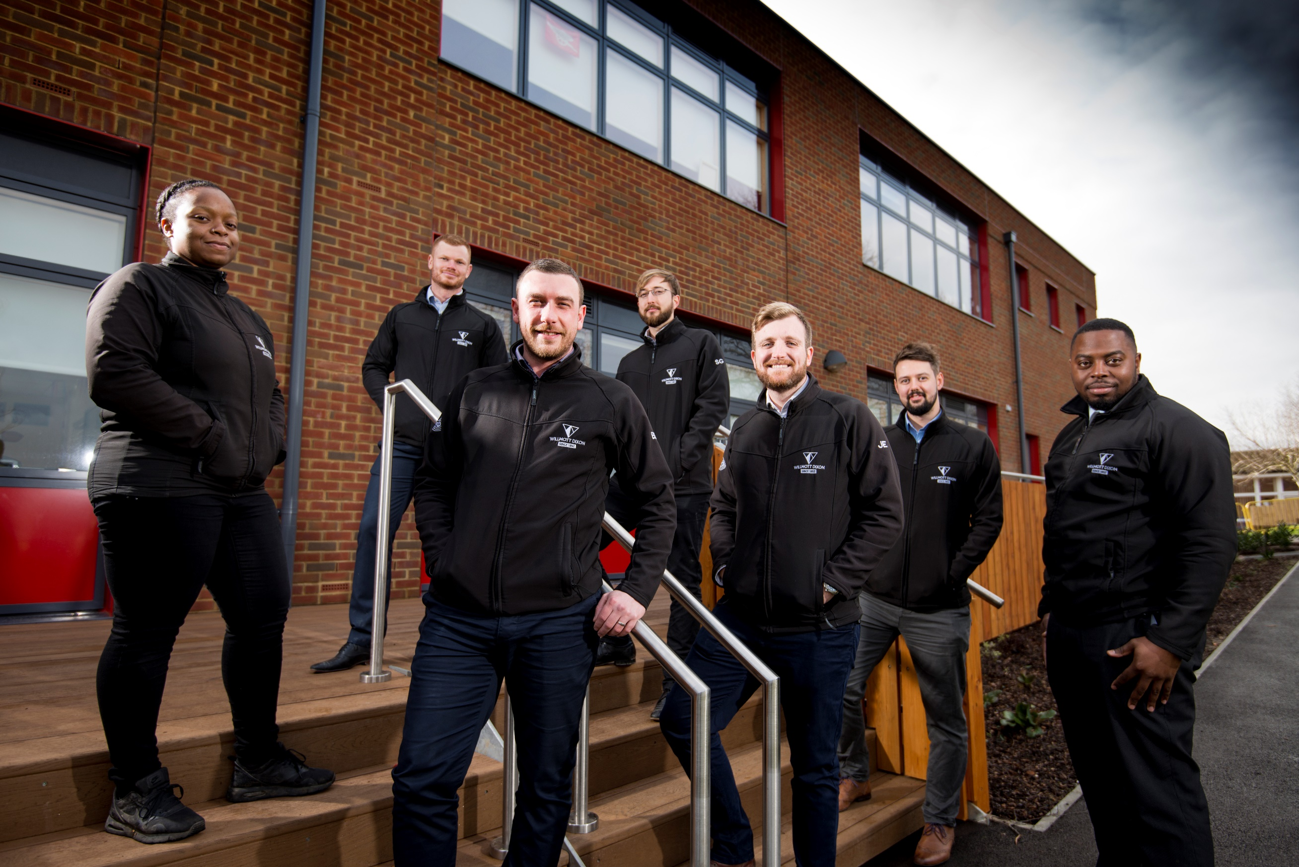
Thank You
Willmott Dixon Spirella 2, Icknield Way, Letchworth Garden City, Hertfordshire SG6 4GY
T: +44(0)1462 671852 F: +44(0)1462 681852 enquiries@willmottdixon.co.uk
willmottdixon.co.uk

